Slide 1
Final Proposal
Jane Kim

Slide 2
Site Map
Home
Classes
About
Gallery
Contact
My website will follow a one-page scroll website.
The pages of my website will follow this order.

Slide 3
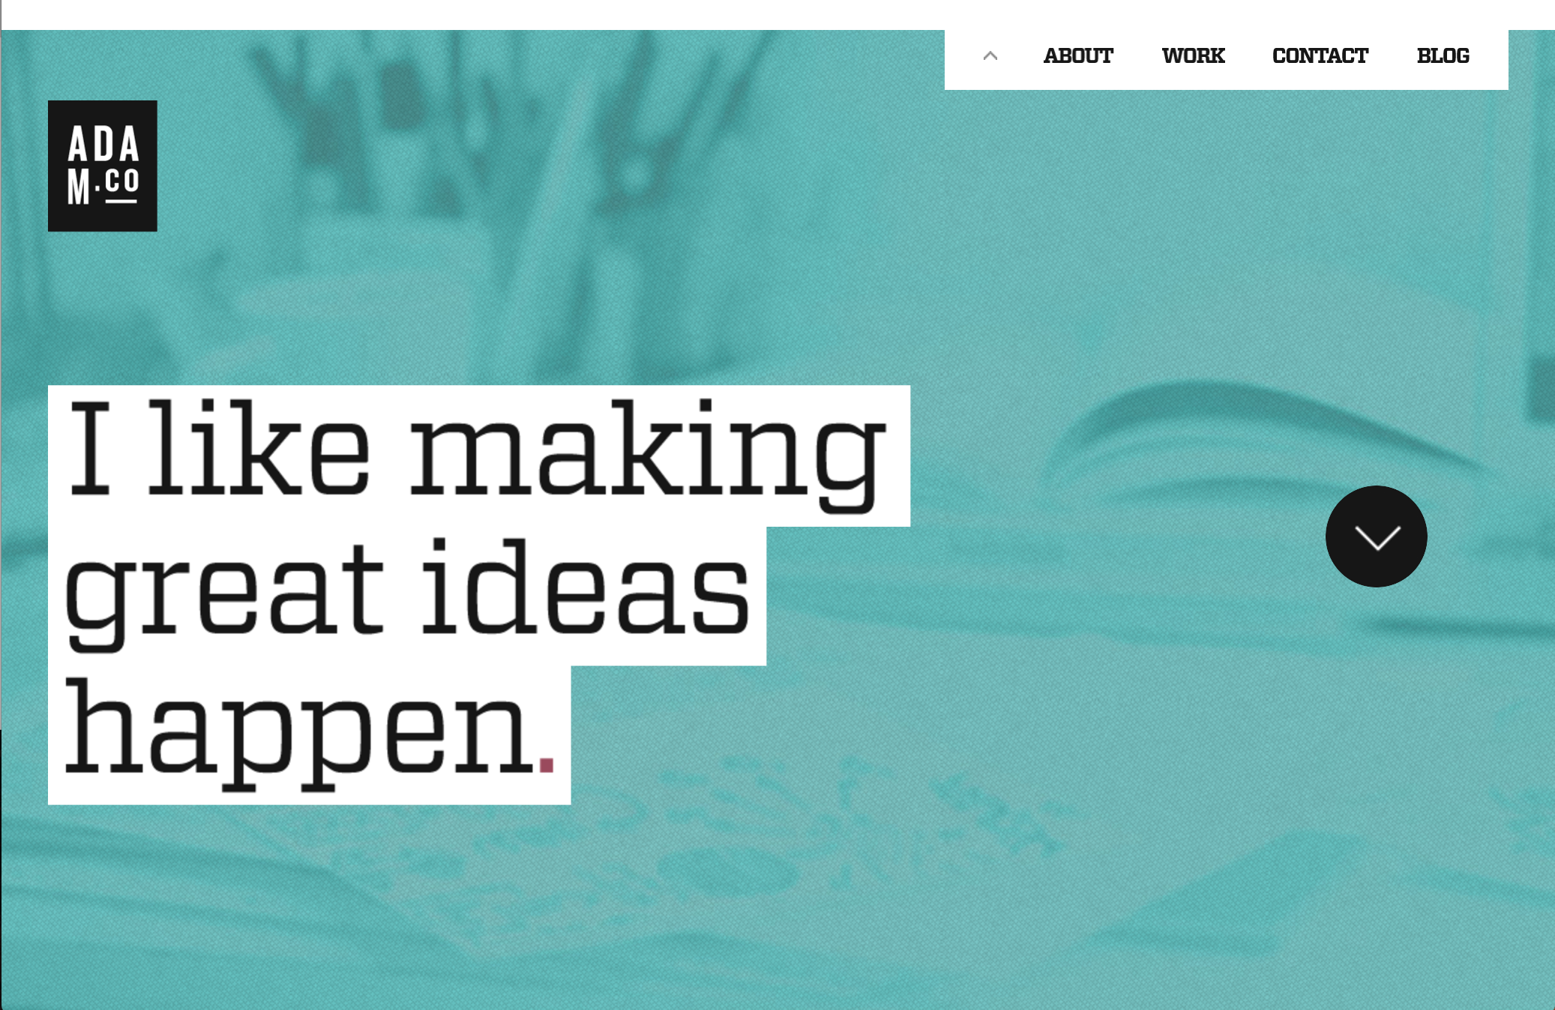
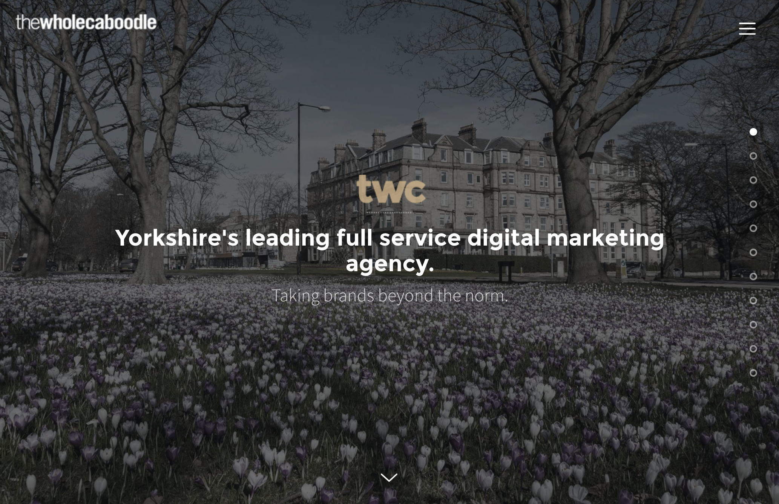
Inspiration
http://adam.co/
I liked how this page was set up using a one-page format, and I loosely based my website format on this one.
https://www.thewholecaboodle.com/
I was inspired by the buttons used on the side of the page to navigate through the different sections.

Slide 4
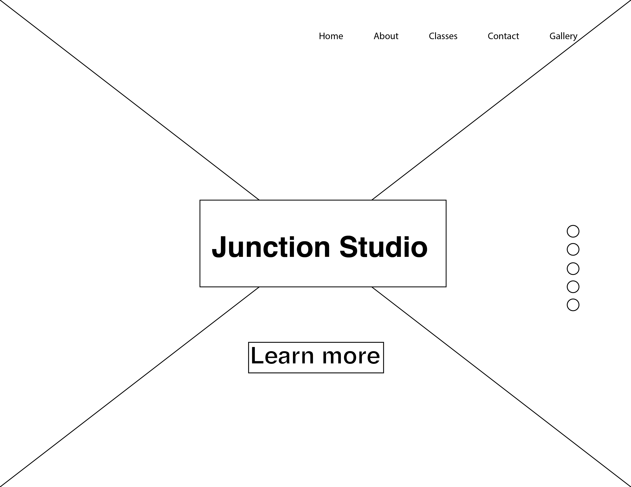
Home Page
There will be a big image covering the entirety of the screen.
The boxes will be partially transparent so that the viewer can see the image.
The buttons on the side are used to navigate the pages.
The navigation bar will be fixed.

Slide 5
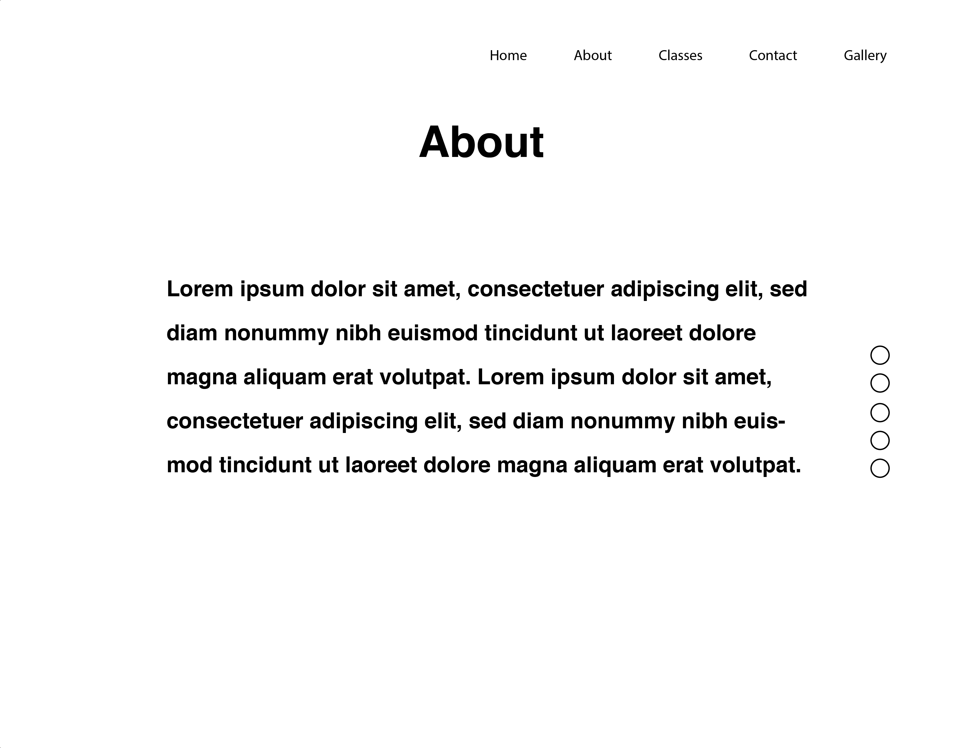
About Page
This is the About page that will have text about the studio in general.
I am not sure if I will be adding images to this page, but I will only have pages for now.
The second button on the right will correspond to this page.

Slide 6
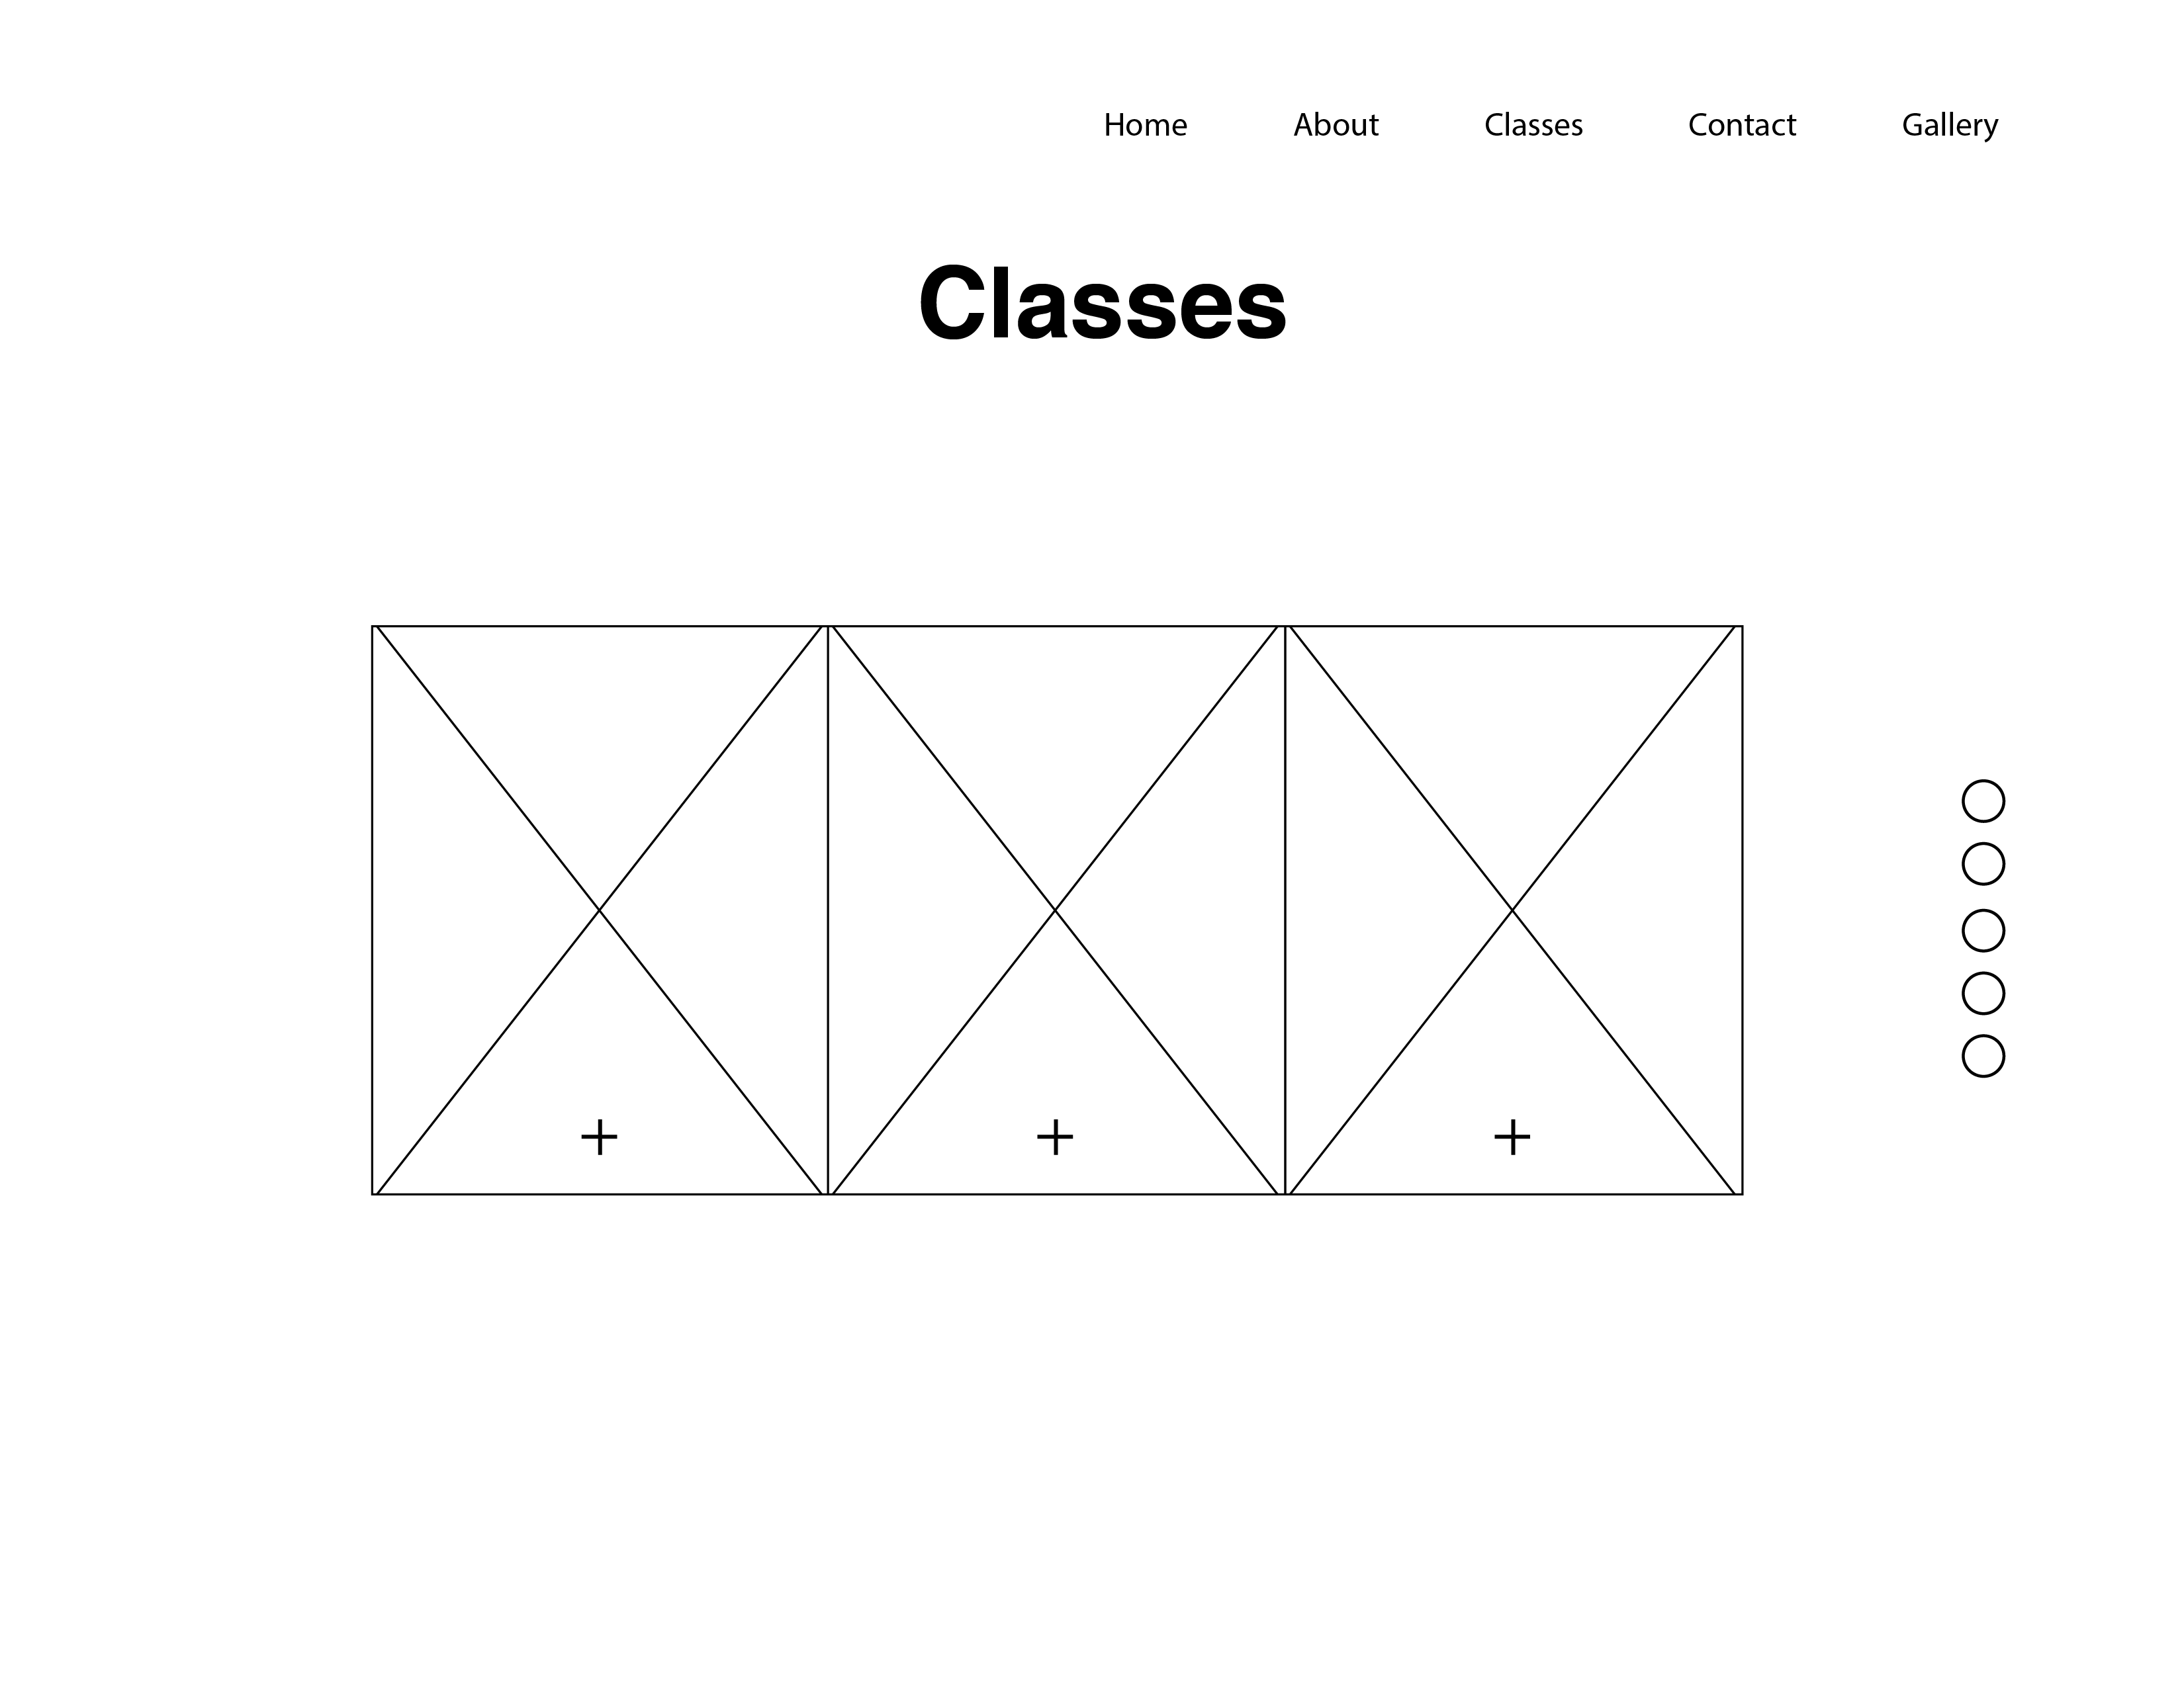
Classes Page
This page will show the different classes offered.
There will be images for the background of the boxes, and it will state what the class is.
When the viewer presses the plus button, there will be a pop up window on the rectangle of the box explaining more about the class.

Slide 7
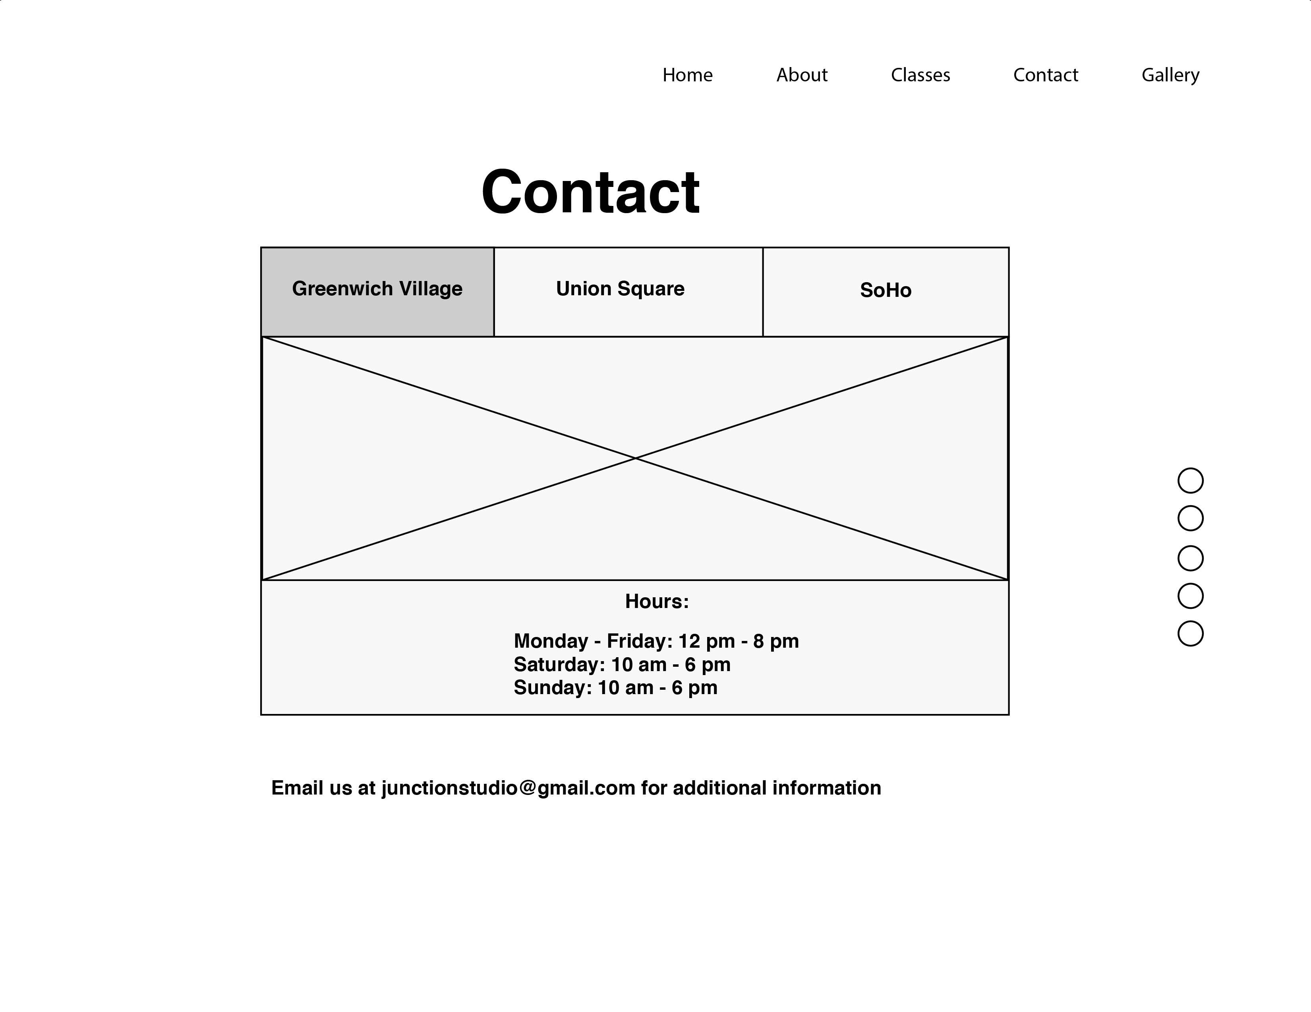
Contact Page
There will be multiple locations for the studio.
There will be different tabs for each location.
The location will show the different locations using google maps. There will also be different hours.
The email will have a pop-up window so that the user can easily email the studio.

Slide 8
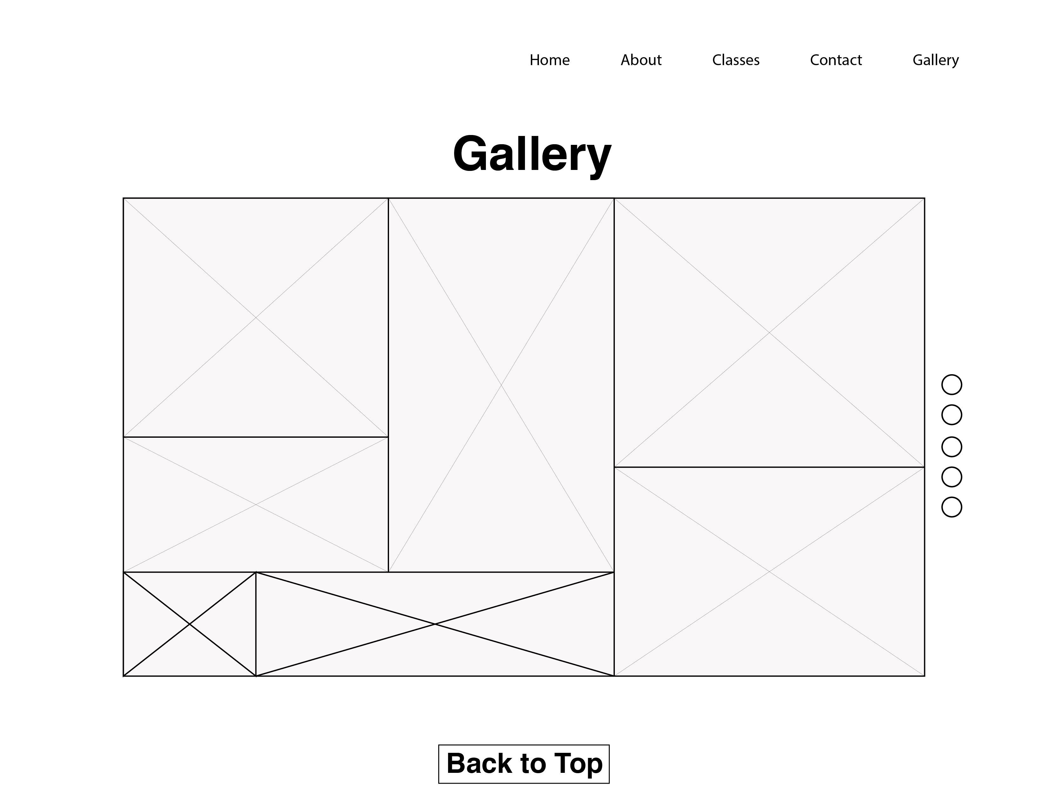
Gallery Page
This page will have different images of art from the studio
There will also be a back to the top button so that the viewer can go to the top of the page quicker.
When hovering over there will be an transparent hover effect.
The viewer will also be able to click the image, and the image will come up in a pop-up window and be bigger in size.

